Slide 1
Image Caption
Generation
Team ID - 11
Sankalp Mule 17D110007
Siddhant Benake 17D110011
Kumar P. Miskin 17D110026
Abeen Bhattacharya 170110013

Slide 2
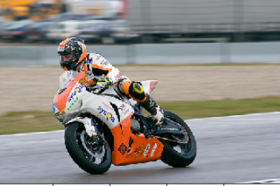
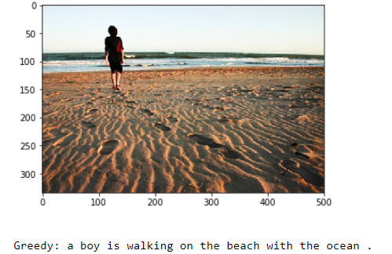
Problem Statement:
Problem statement: To create a sequence of words to describe an image with correct syntax and appropriate semantics
Input: Image
Output: Caption for the image
Output - Motorcyclist is riding an orange motorcycle
Output - A boy is walking on a beach
Input

Slide 3
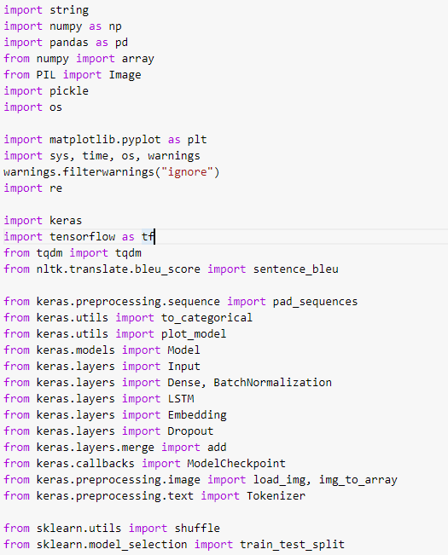
Libraries used

Slide 4
Basic Paper(s)
For the baseline model: 1) Where to put the Image in an Image Caption Generator
URL: https://arxiv.org/pdf/1703.09137.pdf 2) What is the Role of Recurrent Neural Networks (RNNs) in an Image Caption Generator?
URL: https://arxiv.org/pdf/1708.02043.pdf 3) Very Deep Convolutional Networks for Large-Scale Image Recognition
URL: https://arxiv.org/pdf/1409.1556.pdf
For Transformer model
He, Sen, et al. "Image captioning through image transformer." Proceedings of the Asian Conference on Computer Vision. 2020.
URL: https://arxiv.org/pdf/2004.14231.pdf
Herdade, Simao, et al. "Image captioning: Transforming objects into words." arXiv preprint arXiv:1906.05963 (2019).
URL: https://papers.nips.cc/paper/2019/file/680390c55bbd9ce416d1d69a9ab4760d-Paper.pdf
Gained a basic understanding of image, caption pre- processing and transformer architecture in our case
Gained insights about the working principle of the transformer in the case of image captioning

Slide 5
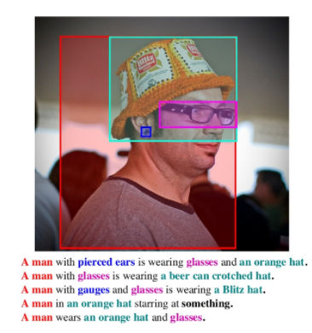
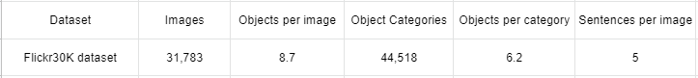
Data - Flickr30K Dataset
Description: Dataset contains 31,783 images with 5 captions for each image, linking mentions of the same entities across different captions for the same image.
URL : https://www.kaggle.com/hsankesara/flickr-image-dataset
Statistics :
Objects - different objects present inside the image
Categories - different categories to which object belong

Slide 6
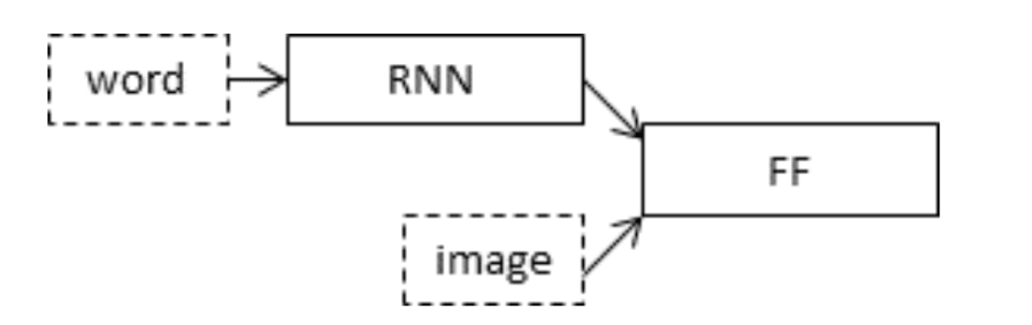
Baseline Model (CNN (VGG16) + LSTM)
The model can be divided into three parts:
Photo Feature Extractor. This is a 16-layer VGG model pre-trained on the ImageNet dataset. We have pre-processed the photos with the VGG model (without the output layer) and will use the extracted features predicted by this model as input.
Text Processor. This is a word embedding layer for handling the text input, followed by a Long Short-Term Memory (LSTM) recurrent neural network layer.
Decoder: Both the feature extractor and sequence processor output a fixed-length vector. These are merged together and processed by a Dense layer to make a final prediction.

Slide 7
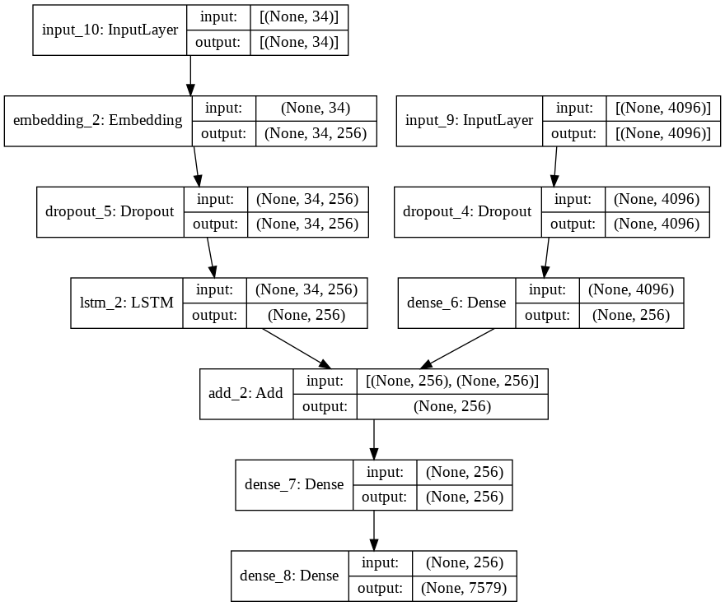
Baseline Model (CNN (VGG16) + LSTM)
Plot of the Model

Slide 8
Improved model (Pretrained CNN + Transformer)
Preprocessed images to be able to input them into Inception V3 (299,299,3)
Used InceptionV3 (pre-trained on Imagenet) to extract features from the last convolutional layer.
Preprocessed caption data(adding sentence ‘start’ and ‘end’ keyword)
Used Positional encoding to take into account the semantics along with the positions of the words
Defined a multihead attention network of transformer for parallel processing
Processed data through multihead attention, FFNN, dropout layer, normalization layers in both Encoder and Decoder
Used ADAM as an optimiser
Image
pre-processing
Pretrained CNN
Transformer
Architecture
Encoder
Decoder
Caption
Caption
pre-processing
vectors

Slide 9
Results:
BLEU Score - Bilingual Evaluation Understudy
It is an algorithm, which has been used for evaluating the quality of machine translated text. We can use BLEU to check the quality of our generated caption as compared to the original caption
Model | BLEU-1 | BLEU-2 | BLEU-3 | BLEU-4
CNN + LSTM | 56 | 30 | 20 | 9
CNN + TRANSFORMER | 43 | 42 | 31 | 38

Slide 10
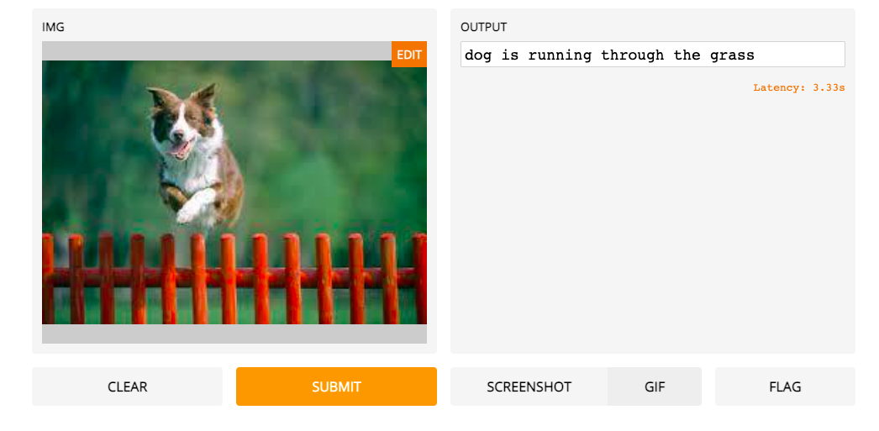
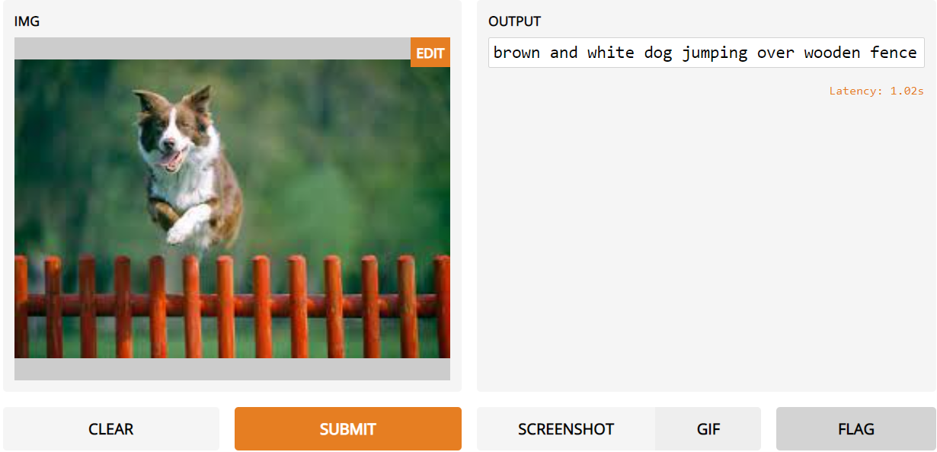
Results: Comparing the results on both the models
Input Image Baseline Model Improved Model
Takeaways: 1) Model has got better at noting colors (brown and white)
2) Model has got better at detecting objects (wooden fence vs grass)
3) Model has improved at observing activities (jumping vs running)
4) Model is more than 3x faster at prediction (latency 1.02s vs 3.33s)

Slide 11
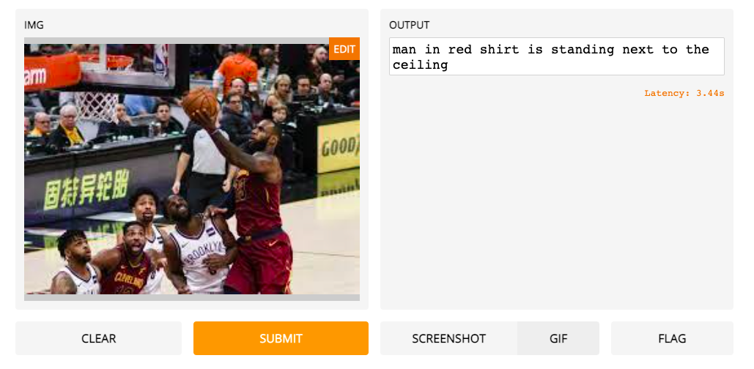
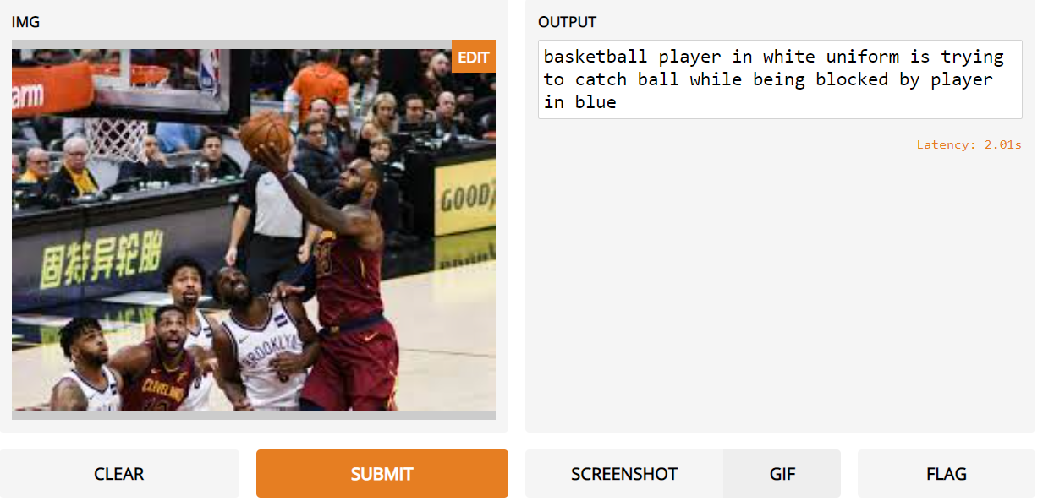
Results: Comparing the results on both the models
Input Image Baseline Model Improved Model
Takeaways: 1) Model has got better at noting colors (white,blue vs red)
2) Model has got better at detecting objects (ball vs nothing)
3) Model has improved at observing activities (baseline model was totally off the real caption)
4) Model is more than 3x faster at prediction (latency 2.01s vs 3.44s)

Slide 12
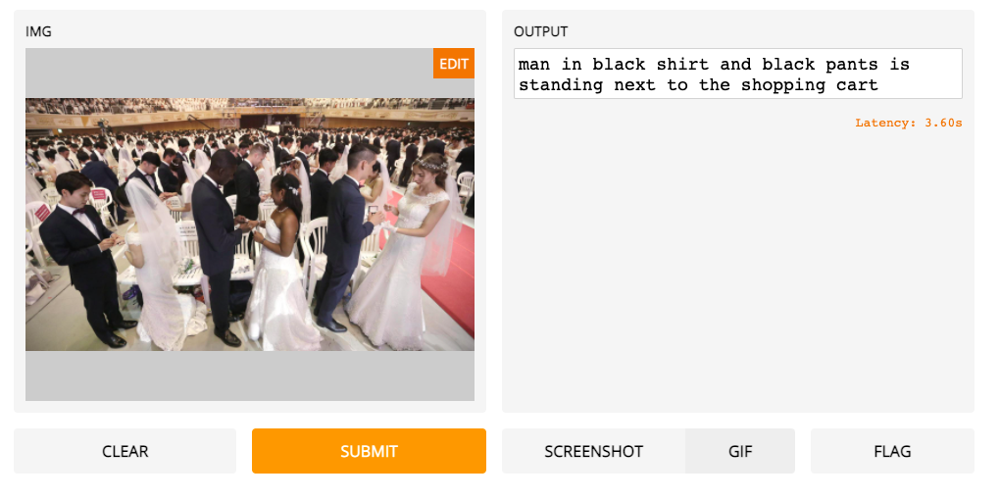
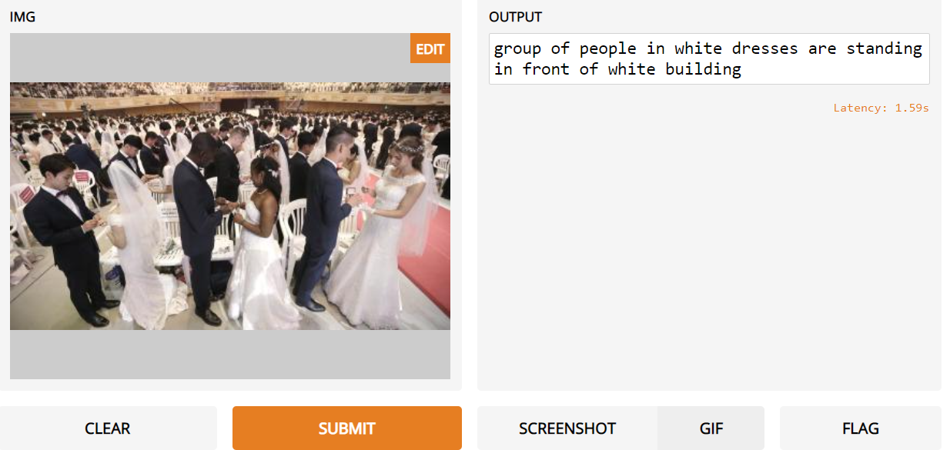
Results: Comparing the results on both the models
Input Image Baseline Model Improved Model
Takeaways: 1) Model has got better at noting people (man next to shopping cart vs group of people)
2) Model is more than 3x faster at prediction (latency 1.59s vs 3.60s)

Slide 13
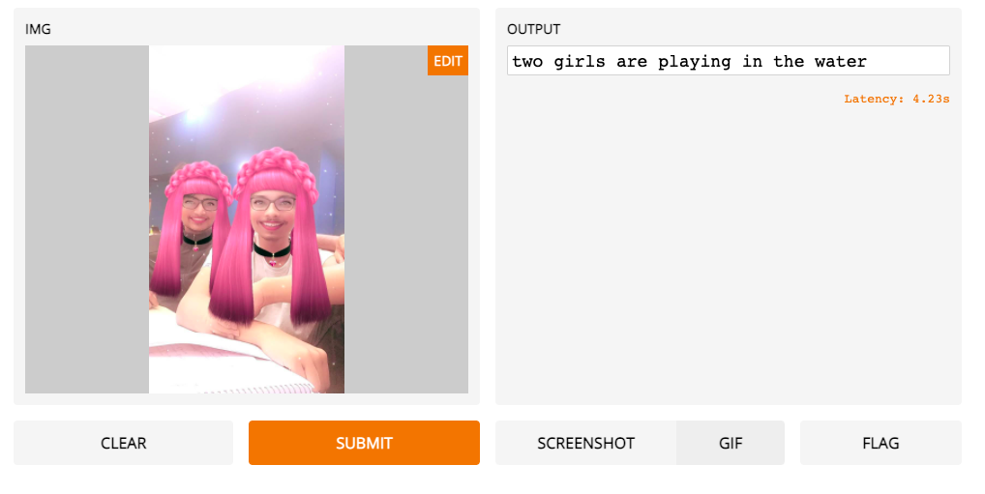
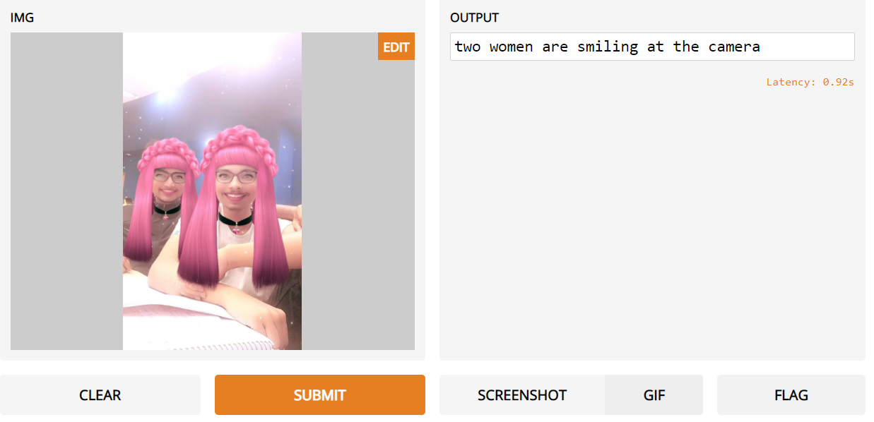
Results: Comparing the results on both the models
Input Image Baseline Model Improved Model
Takeaways:
1) Model has improved at observing activities (smiling at the camera vs playing in the water)
2) Model is more than 3x faster at prediction (latency 0.92s vs 4.22s)

Slide 14
Conclusion and Future Work
Conclusion:
Model is not performing well when there is text present in an image
Transformer is computationally faster as compared to LSTM
Model is performing better when there is some activity happening in image
Future Work:
Training on larger dataset/s for better performance
Implementing state of the art models like BERT or more advanced transformer architectures
Changing the network layer parameters (couldn’t do so because of high training time) followed by hyperparameter tuning

